Slide 1


(IT266 – Project 1) Predicting Rainfall using Machine Learning
Presented by: Guided by:
22IT003 : Ma. Anshuman Prajapati Dr. Priyanka Patel
22IT008: Ma. Jay Bhatt

Slide 2
Introduction
Accurate rainfall prediction holds immense significance across a spectrum of sectors including agriculture, hydrology, disaster management, and urban planning. It serves as a cornerstone for decision-making processes, influencing agricultural practices, water resource management strategies, disaster preparedness measures, and infrastructure development plans. Traditionally, rainfall prediction has heavily relied on physical models, which, while valuable, often face challenges in capturing the complex nonlinear relationships inherent in meteorological data. However, recent strides in machine learning (ML) algorithms offer promising alternatives by harnessing the potential of data-driven models to enhance forecast accuracy.
The study meticulously gathers historical meteorological dataset of annual, monthly and average rainfall (in mm) in different region of India from 1901-2022 from Customised Rainfall Information System (CRIS) under Hydromet Division (HD) of India Meteorological Department (IMD). These datasets encompass a comprehensive columns of previous rainfall records.

Slide 3


Continued..
Falls under SDGs:
1. SDG11 – Sustainable Cities and Communities. 2. SDG13 – Climate Action
Requirements:
Min. 8gb RAM.
Frontend : Android Studio, Java.
Backend : Python.

Slide 4

Flow of application:
Rainfall prediction using machine learning from previous years rainfall data set.
Input (Region+Month+ Year)
Machine Training from dataset
Rainfall Dataset
User
Selection of Best Model
Classification of algorithms
Print predicted value on users screen with
Graph of past year summary
END

Slide 5
Data pre-processing:
Gathered data from govt. site.
Checked null values in each cell
Checked for only numeric value.
Filled null value with mean.
Plotted bar graph for visualisation.

Slide 6
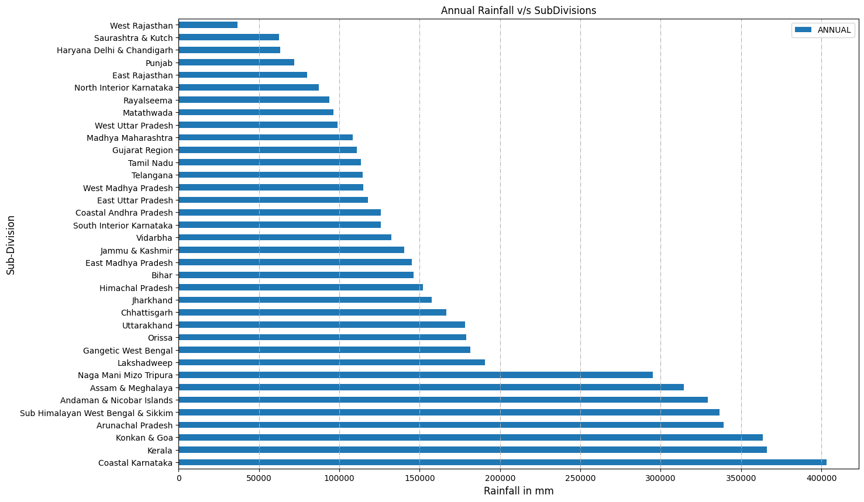
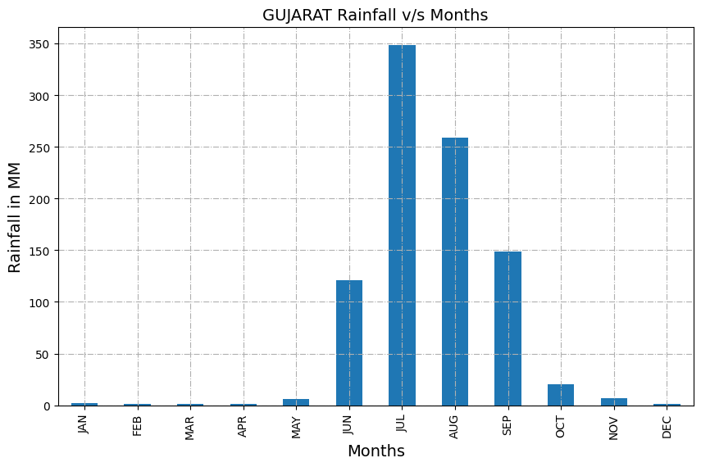
Fig. : Gujarat division annual rainfall visualised
Fig. : All divisions average rainfall visualised

Slide 7
Training section :
Algorithms:
Linear Regression :
Random Forest:
Support vector machine:
Recurrent Neural Network(RNN) :

Slide 8
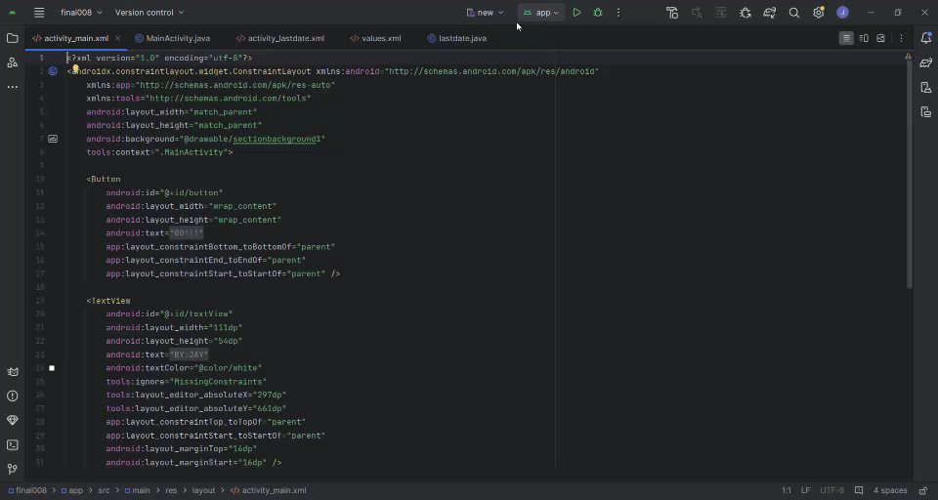
Application section :

Slide 9
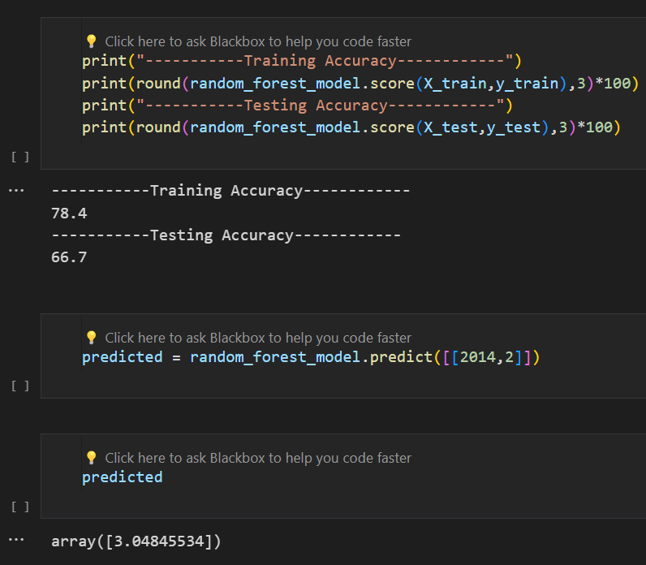
Results:
The Random Forest Model had given best results of all models.

Slide 10
References:
Dataset: https://hydro.imd.gov.in/hydrometweb/(S(o3m03x55t5vpjh2zodv0zmid))/landing.aspx

Slide 11


